Slide 1
Finance, Accounting, & Credit FAANG STOCKS
Dala dala group
Peris, Karanja, sylvia

Slide 2
DATA FLOW
Purpose
The data shows performance of different stocks within a given timeframe mostly daily
It shows different price range for the stocks
STOCKS NAMES
Netflix
Amazon
TERMS USED
OPEN
Apple
Facebook
Google
CLOSE
HIGH
LOW
VOLUME
ADJUSTED CLOSE

Slide 3
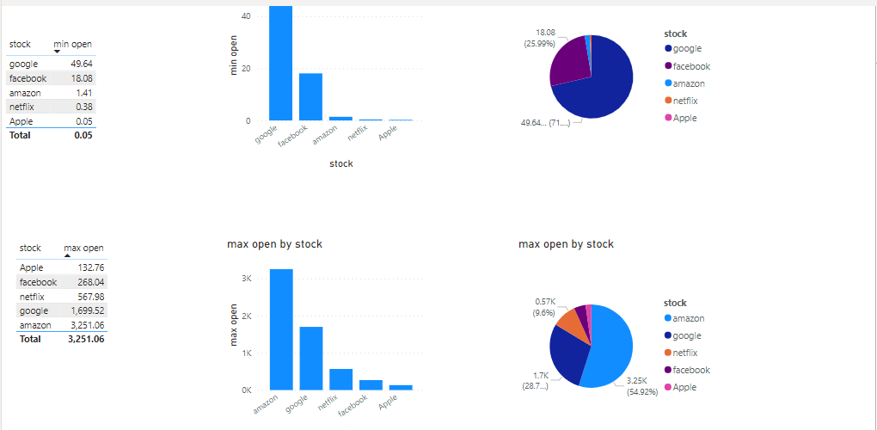
OPEN PRICE
The price at which a stock begins trading on a particular trading day.
The open price is crucial as it sets the starting point for the day's trading activity. It's the first transaction price when the market opens.

Slide 4
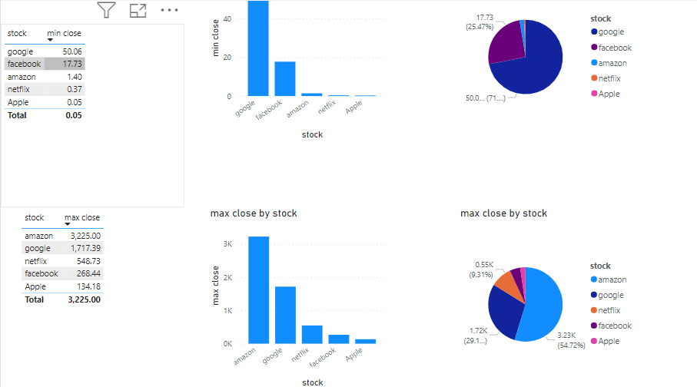
Close price
The last traded price of a stock at the end of the trading day.
The close price reflects the final consensus of the market for the day. It's the price at which the market values the stock when trading concludes.

Slide 5
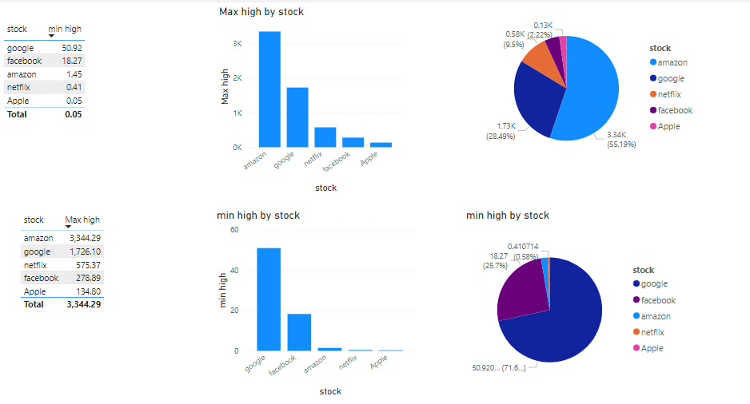
High Price
The highest traded price of a stock during a specific time period, often a day.
The high price indicates the peak value the stock reached during the trading day. It's a key indicator of upward price movement.

Slide 6
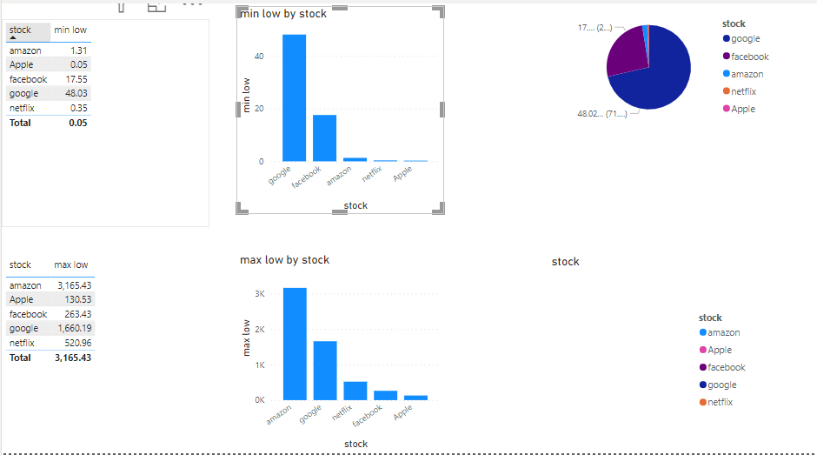
Low Price
The lowest traded price of a stock during a specific time period, typically a day.
The low price signifies the lowest value the stock reached during the trading day. It's a crucial metric for understanding downward price movement.

Slide 7
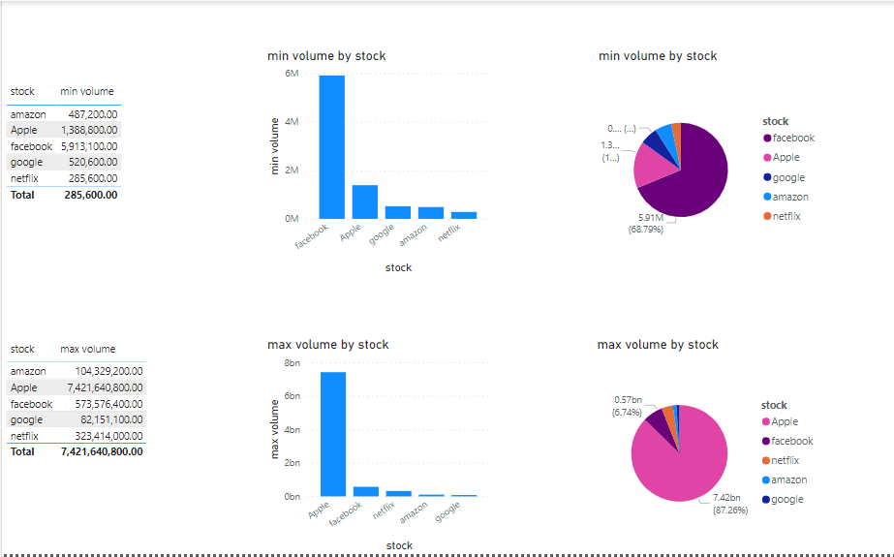
Volume
The total number of shares traded during a specific time period.
Volume is a measure of market activity. High volume often accompanies significant price movements, indicating strong investor interest.

Slide 8
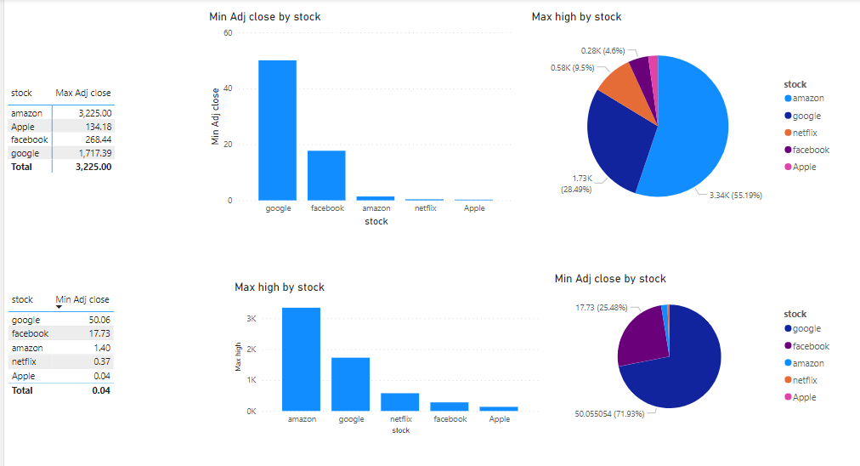
Adjusted Close
The stock's closing price adjusted for events such as dividends, stock splits, or new stock offerings.
The adjusted close accounts for corporate actions, providing a more accurate representation of the stock's true performance over time.

Slide 9
these terms collectively provide a snapshot of a stock's performance within a given time frame. If you're analyzing a daily stock chart, you would look at the open, close, high, and low prices along with the trading volume. The adjusted close is particularly useful for long-term analyses, as it accounts for factors that might affect the stock's historical prices.
Below is how to use them to analyze both daily trading and long term long term investment.

Slide 10
Daily Trading:
Open and Close Prices:
Strategy: Look for price gaps between the open and close. A larger gap may indicate higher volatility and potential trading opportunities.
Example: If a stock opens significantly higher than its previous close and maintains strength throughout the day, it might signal a bullish trend.
High and Low Prices:
Strategy: Monitor intraday highs and lows for potential breakout or breakdown points.
Example: If a stock hits a new intraday high, it could be a signal to enter a long position. Conversely, if it drops to a new low, it might trigger a short-selling opportunity.
Volume:
Strategy: High volume often confirms the strength of a price movement.
Example: A stock breaking out on high volume is generally considered more reliable than a breakout with low volume, as it suggests broader market participation.

Slide 11
Long-Term Investing
Adjusted Close:
Strategy: Use adjusted close for a more accurate representation of a stock's historical performance, especially when accounting for dividends, stock splits, or other corporate actions.
Example: Adjusted close prices are crucial for calculating long-term returns and understanding the true value appreciation of a stock.
Volume:
Strategy: Analyze long-term trends with attention to volume patterns.
Example: Consistent high volume during an uptrend may signify strong investor confidence, while declining volume during a rally could indicate weakening interest.
Open and Close Prices:
Strategy: Examine the closing prices over extended periods for trend analysis.
Example: A series of higher closing prices over months or years may indicate a long-term uptrend, providing a basis for holding a stock.
High and Low Prices:
Strategy: Identify historical support and resistance levels for long-term trendlines.
Example: Previous highs that act as resistance and previous lows that act as support can help you make informed decisions about entering or exiting positions.

Slide 12
CONCLUSION
In both daily trading and long-term investing, it's essential to combine technical analysis with fundamental analysis, considering factors like company financials, industry trends, and economic conditions. Additionally, risk management strategies, such as setting stop-loss orders, should be part of your overall approach to mitigate potential losses.

